Slide 1
Project Management Exam Concept Review

Slide 2
Concepts You’ll Need to Know
Software development life cycle
Kanban vs. Scrum
Kanban boards & swim lanes
Definition of project management
Role of the project managers
Project manager software
Waterfall
Critical paths and GANTT charts

Slide 3
Software Development Life Cycle

Slide 4
Software Development Lifecycle (SLDC)
Analysis
Design
Implementation
Testing
Deployment

Slide 5
Analysis
Figure out what you need
Gather requirements
Consult everyone who has stake in the project
Management
Customer
Subject matter experts

Slide 6
Design
What do you do to meet those requirements?
Plan out your project

Slide 7
Implementation
Do your project
Requires the most people
Is the most complex
Is the most subject to delays

Slide 8
Testing
Did you did a good job?
Does everything work?
Does it meet the requirements?
Is the customer satisfied?
Find and fix all the bugs / issues

Slide 9
Deployment
Prepare for launch
Put the results of your project into action

Slide 10
What is Project Management?
The application of knowledge, skills, tools, and techniques to produce activities to meet the project requirements

Slide 11
What does a Program Manager Do?
Program Manager
Project Manager
Oversee multiple large projects
Oversees one project

Slide 12
What Does a Project Manager Do?
Resources – time and cost
Scope
Communication

Slide 13
Product vs. Sprint Backlog
Product
Sprint
All known tickets
Wishlist
Goes beyond the sprint
Only what you can tackle in the sprint
Pull from the product backlog to fill

Slide 14
Project Management Software
Jira – Gold standard for Scrum
Team Foundation (TFS) – like Jira, but less widely used and integrated with Microsoft
Trello – Scrum, to-do lists, etc.
Liquid Planner – Waterfall
Microsoft Project - Waterfall

Slide 15
Waterfall Project Management
Specific start and end dates
Long-term planning
Less adaptable / flexible

Slide 16
Stages of Waterfall Methodology
Requirements
Design
Implementation
Verification
Maintenance

Slide 17
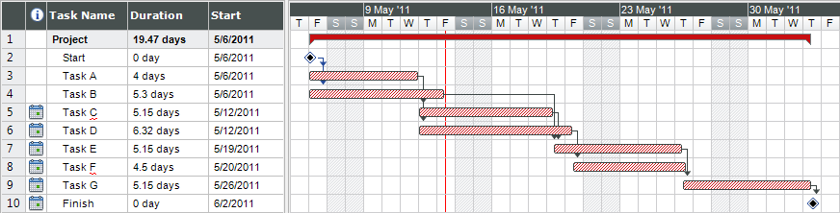
GANTT Charts
Shows the workflow for a project
What can be done at the same time?
What must be done before the next task takes place?
How long will each task take?

Slide 18
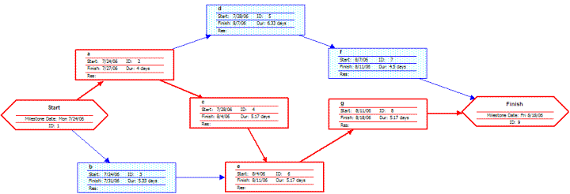
Critical Path
Part of a GANTT chart
The series of tasks that takes you to final delivery
You are looking for the longest pathway – because that limits the workflow

Slide 19
Questions?

